Slide 1
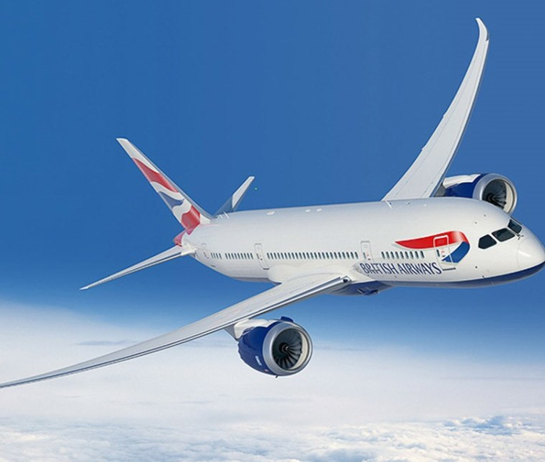
British Airways
Sentiment Analysis
This Photo by Unknown author is licensed under CC BY-SA.

Slide 2
Based on the sentiment analysis of 1000 reviews, it appears that a majority of the reviews have been polarized into positive and negative categories.
The reviews then sub-divided into different labels such as service, entertainment, airline punctuality, etc. For label-wise sentiment analysis.
55% passengers complain about airline punctuality, 46% experience uncomfortable seats, 37% do not like the food and 34% passengers have issue with the service. So, airline must focus on these issues for future business growth.

